Slide 1


CVCS Escapement Modeling
Testing the CVCS Escapement Model
Presented by:
Arthur Barros, California Department of Fish and Wildlife
Arthur.Barros@wildlife.ca.gov

Slide 2
Session goals
Review differences between escapeMR methods and our code.
Compare results using example data.
Simulate populations to try and compare model accuracy.

Slide 3

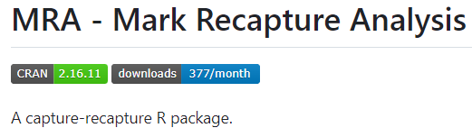


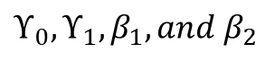
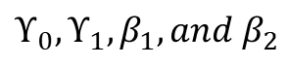
Comparing our code to escapeMR
Data preparation
MLE optimization
Escapement Estimate
ch, cap_X, surv_X, initial_beta
optim()
$$ϒ_{0}, ϒ_{1}, β_{1}, and β_{2}$$
CJS_data_prep()
total_escapement()
ch, cap_X, surv_X, initial_beta
$$ϒ_{0}, ϒ_{1}, β_{1}, and β_{2}$$
Optimization algorithm:
escapeMR: VA09AD (FORTRAN)
R optim(): Broyden-Fletcher-Goldfarb-Shanno (BFGS)

Slide 4
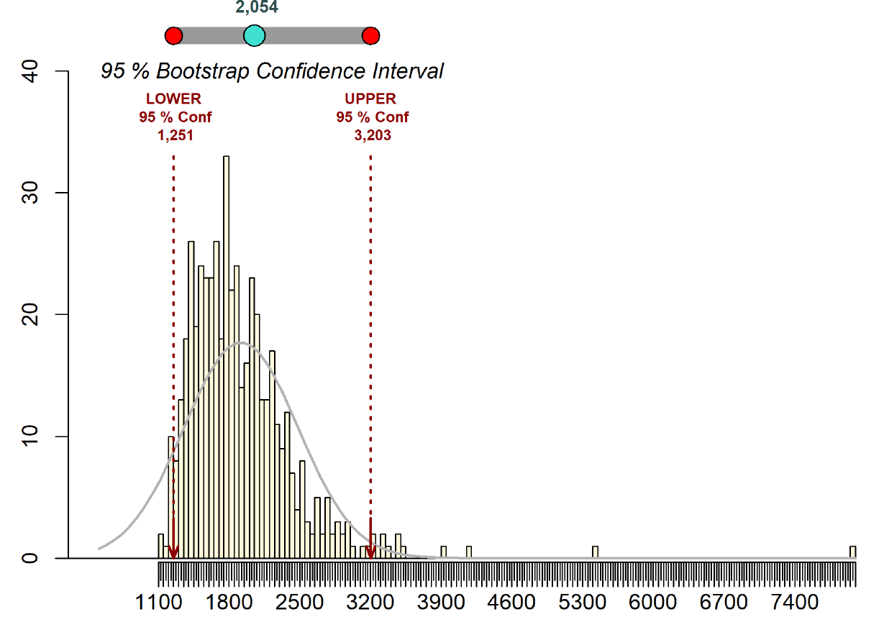
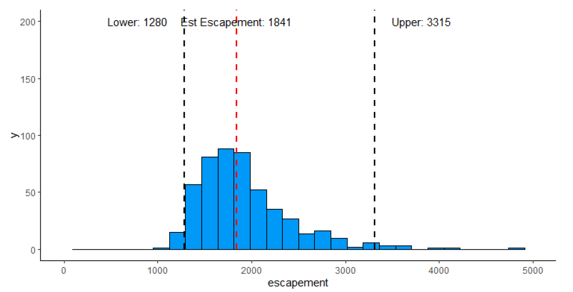
Comparing our code to escapeMR
Demo data; nan=153, ns=5, chops=221, 500 iterations

Slide 5
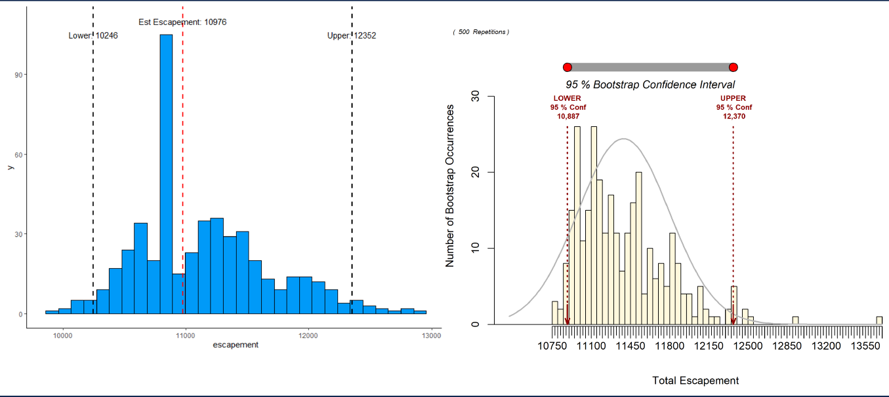
Comparing our code to escapeMR
American R. 2021; nan=1359, ns=12, chops=3885, 500 iterations

Slide 6
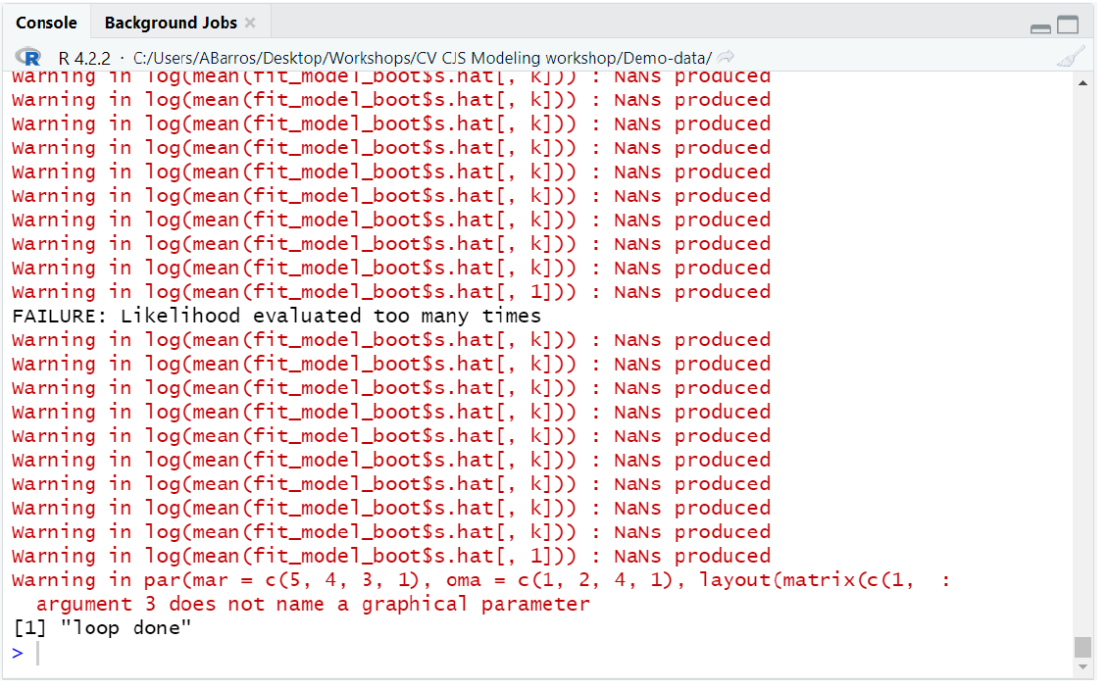
escapeMR failure to converge
ARC 2021, 500 iterations

Slide 7
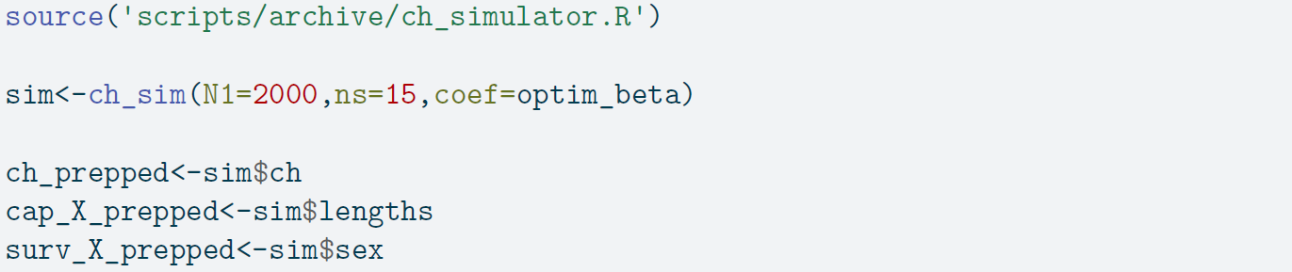
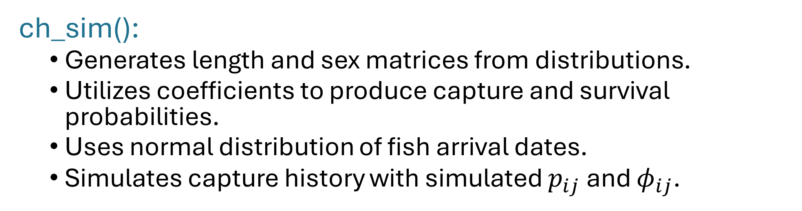
Simulating a population with ch_sim()
ch_sim():
Generates length and sex matrices from distributions.
Utilizes coefficients to produce capture and survival probabilities.
Uses normal distribution of fish arrival dates.
Simulates capture history with simulated $p_{ij}$ and ${\text{φ}}_{ij}$.

Slide 8
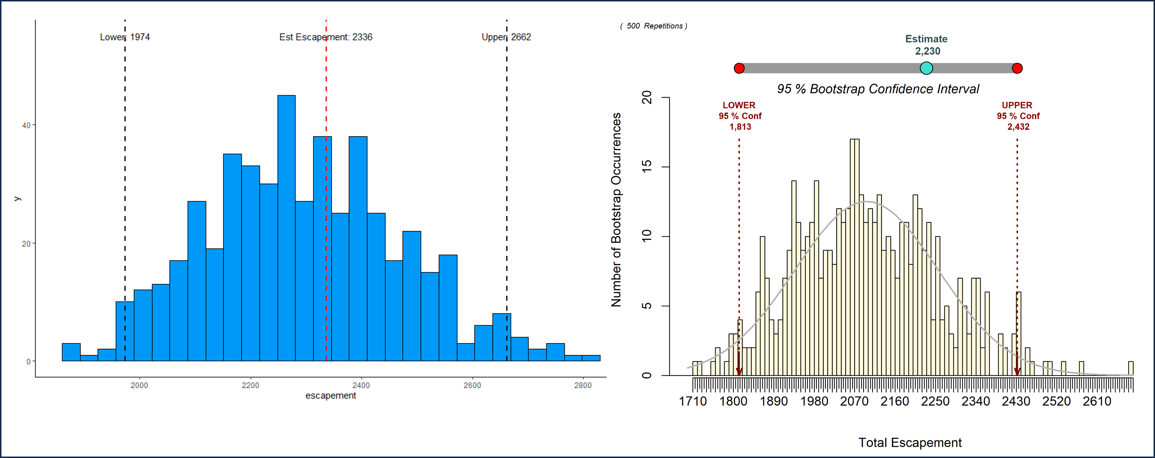
Simulated populations

Slide 9
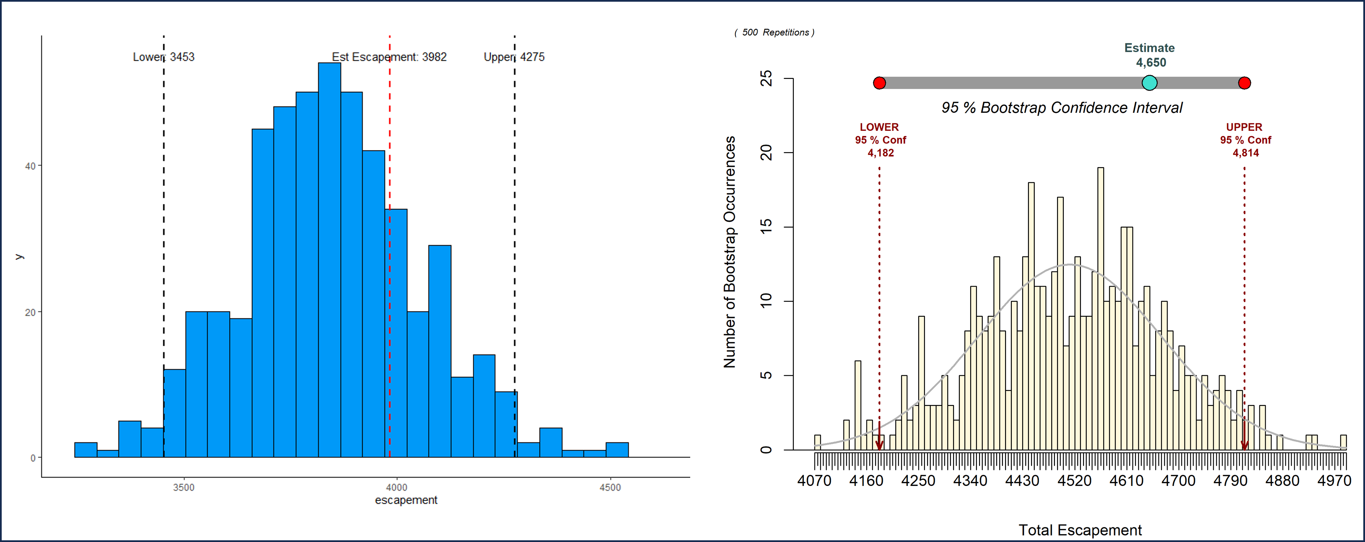
Simulated populations

Slide 10
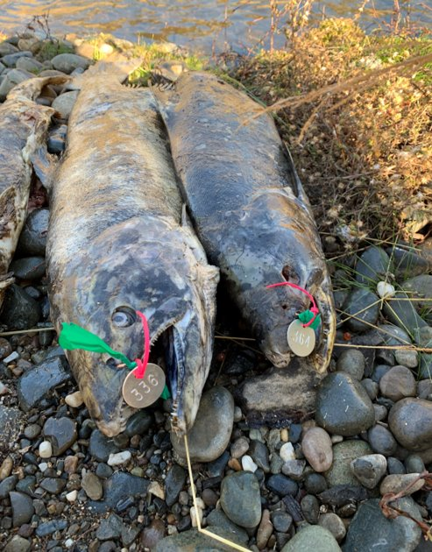
Wrapping up
For smaller datasets both methods produce similar estimates and precision, while escapeMR is faster.
For some datasets, like 2021 America River, escapeMR VA09AD algorithm may fail to converge, resulting in failure to estimate abundance.
Using data from simulated populations, escapeMR was biased for larger datasets.
R optim() method, even with Rcpp boost, isn’t as fast as escapeMR, unless escapeMR fails to converge.

